Slide 1
IRONHACK FINAL PROJECT Predict IMDB Movie Rating
Duygu ATALAY

Slide 2
INDEX OF CONTENTS
Introduction | Short description about database and purpose of the project
Process | Data Cleaning, EDA, Data Wrangling, Model
Insights | Explain what we have in our database
Results | What are the answer of our main question?

Slide 3

INTRODUCTİON
We have a movie database consisting of 4 json files. These files are :
Genre
Movie_budget
Movie_contents
Movie_contents9
We are using a parser to create a database from these json files, from imdb and some other websites.

Slide 4
INTRODUCTİON
Our Main Question : How can we tell the greatness of a movie before it is released in cinema?
Which features affect the greatness of a movie before it is released in cinema?

Slide 5
PROCESS
01
02
03
04
DATA CLEANİNG
EXPLORE THE DATABASE
DATA WRANGLING
MODEL

Slide 6
INSIGHTS
After analyzing the database and observe correlation between variables we can see some status. For example:
Are the movie awards correlated to the worldwide gross ?
Does the more a movie is a liked, the more the casting is liked ?

Slide 7
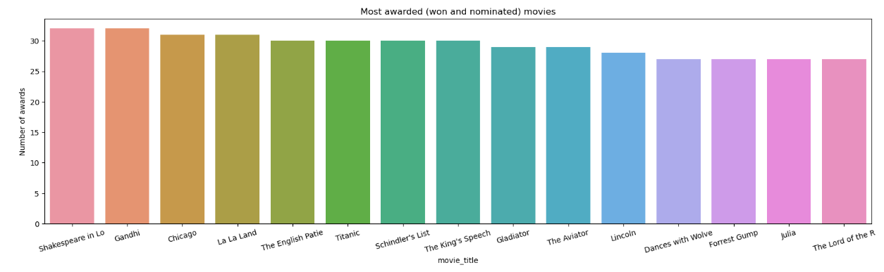
INSIGHTS
Here is the most awarded movies in our database.

Slide 8
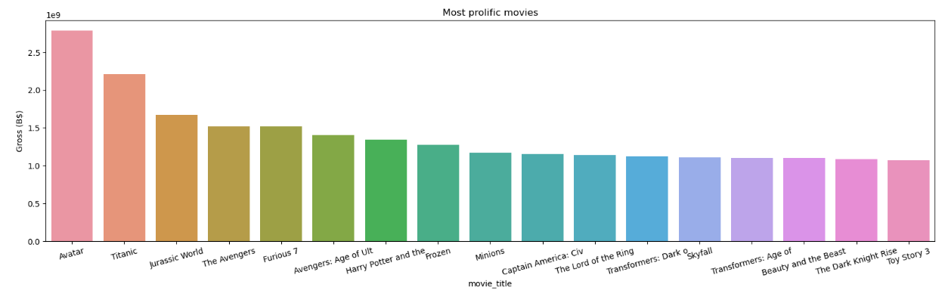
INSIGHTS
Here is the most profolic movies in our database.

Slide 9
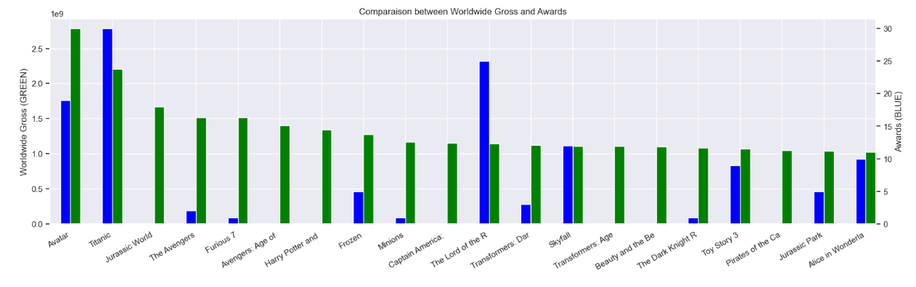
INSIGHTS
As we can see the green columns are the awards, and the blue columns are the Worldwide gross of the movies. The highest awards and the highest gross is not belongs to the same movie.

Slide 10
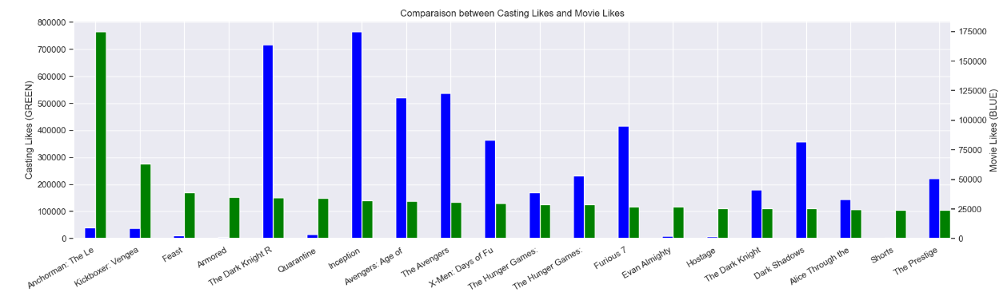
INSIGHTS
Here is another interesting insight from the database. Green columns are the casting likes and the blue columns are the movie likes. There is a huge diffence between the casting and movie likes. “Anchorman: The Legend of Ron Burgundy“ has the highest casting likes but the movie likes are very low.
”

Slide 11
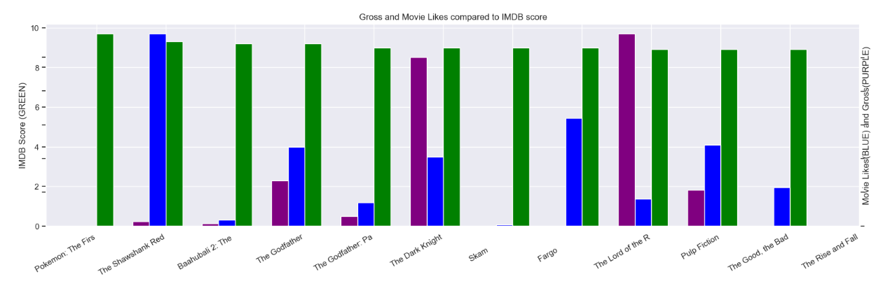
INSIGHTS
Finally I want the show this graph. Green columns are IMDB scores, blues are movie likes and the purples are the Gross. As we can see the highest Gross belongs to the “Lord of the Rings” and the IMDB Score is high enough but the highest movie likes goes to “The Shawshank Redemption”

Slide 12
THREE STEPS TO THE RESULTS
STEP 1
STEP 2
STEP 3
The first part aims to parse data from the imdb and the some other websites
The second part is to analyze the database and observe correlation between variables
Machine Learning to predict the IMDB score with the meaningful variables.

Slide 13
RESULTS
MODEL
SCORES
We have already talked about the two steps before getting the results. Our third step is choosing the Machine Learning Model to predict the variables.
After applying these three models to my test and train sets the results are like these:
Training Score GradientBoosting: 0.78
Test Score GradientBoosting: 0.44
Training Score AdaBoostRegressor: 0.35
Test Score AdaBoostRegressor: 0.34
Training Score RandomForest: 0.92
CHOOSING
I tried there Machine Learning Models to find the best. These are:
Gradient Boosting Regressor
Ada Boost Regressor
Random Forest Regressor
According to the highest score we are using a Random Forest algorithm to find the most important features to predict the movie greatness.

Slide 14
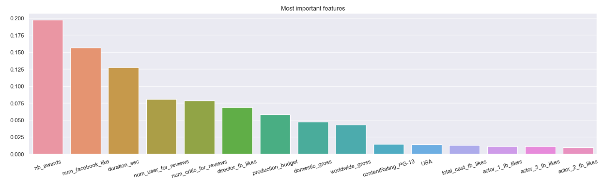
RESULT
Finally Random Forest gave us the these most important features that shows the greatness of a movie before it is released in cinema.

Slide 15
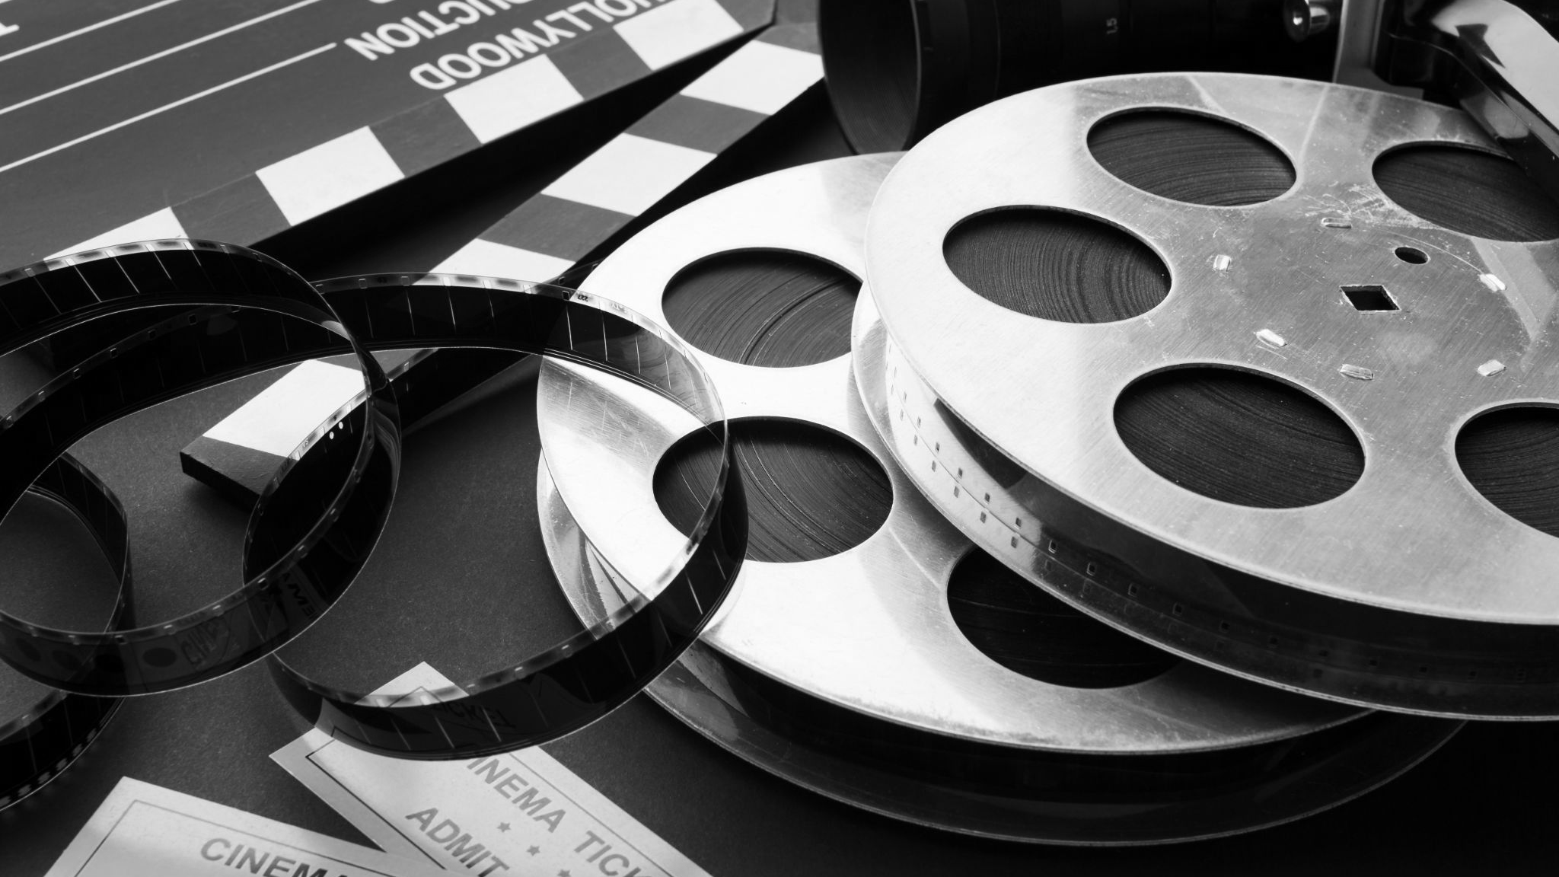
THANKS FOR YOUR TİME!
Does anyone have any questions?

Slide 16
THANKS!
Does anyone have any questions?
addyouremail@freepik.com
+91 620 421 838
yourwebsite.com
Please keep this slide for attribution

